Slide 1
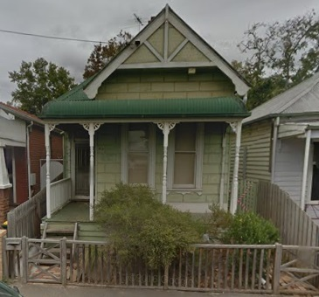
Capacity Population Estimates for Arden-Macaulay by John Widmer http://scitech.net.au/population
Resident, Barnett street
Kensington

Slide 2
My quest for information about the impacts of C190 on my neighbourhood started when City of Melbourne Strategic Planning Dept’s Leanne Hodyl could not answer questions at an information session held in Kensington. Later she replied by email, that:
“As requested, the capacity estimate for the area north of Macaulay Road and west of the Moonee Ponds Creek is 1492 dwellings. Assuming 1.7 people per household this equates to a population estimate of 2536. This is approximately 80 dwellings per hectare (gross calculation - that is including the parks and roads in this area).”
My own knowledge of the relevant Census data lead me to believe this information was incorrect. So I sought evidence of the City of Melbourne method and data used in reaching this estimate.

Slide 3
City of Melbourne’s Capacity Study for Arden-Macaulay
7th January, 2011
Total # dwellings (all precincts): 7,203
To these 7,203 dwellings, the study adds back dwellings that are recently built or under construction, or have planning permits, to arrive at the total capacity for the whole of Arden Macaulay:-
Estimated Population of Residents by 2040 | 14,000 residents
Estimated Dwellings | 8,500

Slide 4
City of Melbourne’s Capacity Study for Arden-Macaulay, Addenda 1,2,3
Addendum 1 of the Arden-Macaulay Capacity Study, 19th November 2012
Estimated Population of Residents by 2040 | 20,500 residents
Estimated Dwellings | Not provided
Addendum 2 of the Arden-Macaulay Capacity Study, 27th June 2013
Estimated Population of Residents by 2040 | 20,128 residents
Estimated Dwellings | Not provided
Estimated Population of Residents by 2040 including 30% additional building height | 23,730
Addendum 3 of the Arden-Macaulay Capacity Study, 6th August 2013
Estimated Population of Residents by 2040 | 20,786 residents
Estimated Dwellings | Not provided
Estimated Population of Residents by 2040 including 30% additional building height | 24,864

Slide 5
Here’s what you’ve said to residents and stakeholders:
Arden Macaulay urban renewal area (inclusive of Stages 1 & 2) has a capacity population of:
Document Where Cited | 2011 | 2031 | 2040+
Draft A-M Structure Plan, May 2011 |  |  | 25, 000
Published A-M Structure Plan, June 2012 | 2,670 | 12,816 | 20,500

Slide 6
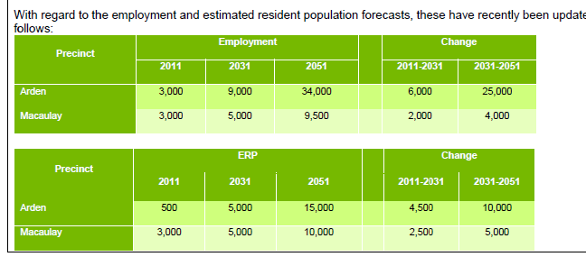
And today’s tabled report to the Future Melbourne Committee suggests that the MPA and MMRA independently arrived at estimates in the same order of magnitude.
What is the source of this data?
Agenda 6.3, Future Melbourne Committee 2nd Aug 2016 | 2011 | 2031 | 2051
Arden | 500 | 5,000 | 15, 000
Macaulay | 3,000 | 5,000 | 10,000
Total for Arden-Macaulay |  | 10,000 | 25,000

Slide 7
My Analysis, street by street, per DDO for Area 4
My analysis, provided to you, predicts that up to 5,180 apartment dwellings could be constructed, which could result in up to 8,800 residents for the north-west quadrant of Stage 1 (C190) of Arden Macaulay, labelled Precinct 4 (Refer diagram).
Precinct 4 represents approximately 15% of the whole of Arden-Macaulay, and is proposed under C190 to have a built form predominantly of 6-levels, with some streets that have a ‘residential interface’ being 3 – 4 levels, and a few sites on Racecourse Rd being 9-level s.

Slide 8
Population estimates not credible
City of Melbourne’s Arden-Macaulay population estimates of a capacity population of 25,000 residents for the whole of Arden-Macaulay are at best, mistaken, or at worst , misleading.
There are NO breakdowns or subtotals by precinct or DDO area.
An analysis based on the DDO for the north-west Quadrant of C190 (Stage 1) is provided to you and predicts 3 to 4 times the population you have allowed for.
A duty is owed by Councillors , that cannot be delegated, to ensure the transparent and diligent preparation of reports (including modelling) upon which residents, investors, indeed all stakeholders must rely to make informed decisions.

