Slide 1
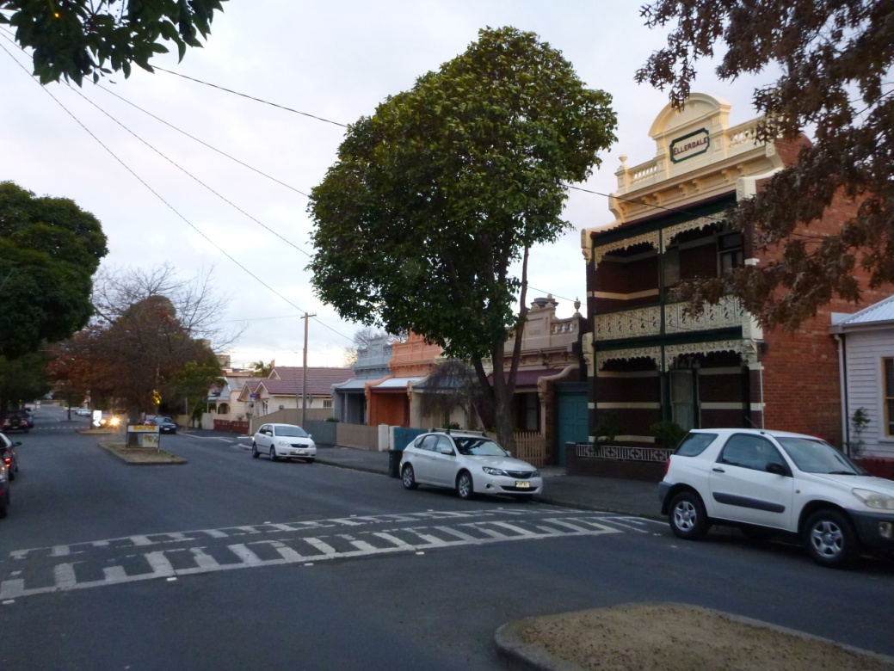
Macaulay Precinct
Crowded Kensington – What the Australian 2011 Census shows

Slide 2
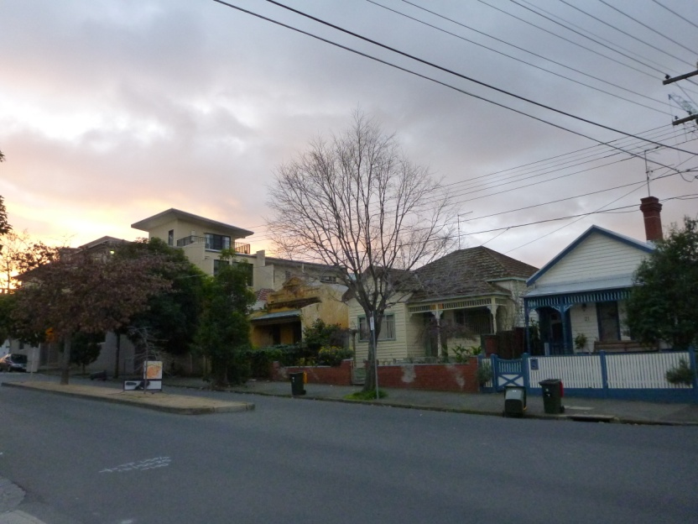
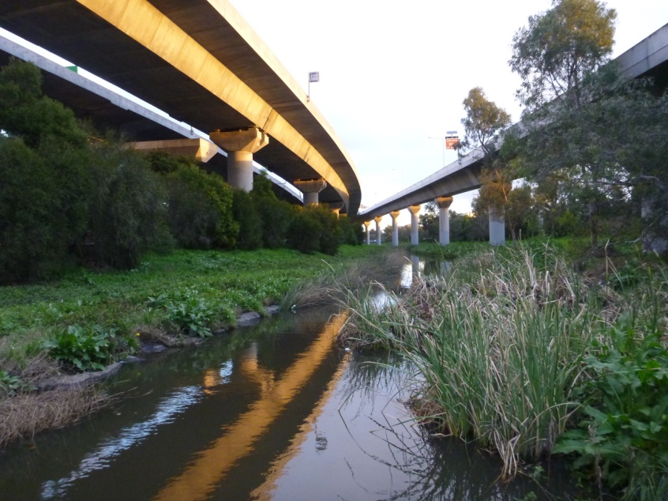
Australian National Census 2011
Census data shows the number of citizens in the precinct
Mapping data allows a density analysis of the area where people actually live
Density calculations must exclude railways, toll ways, main roads, private businesses, drains, levee banks indeed any space not shared with residents.
North Macaulay Precinct Street
Do citizens really use this space?

Slide 3
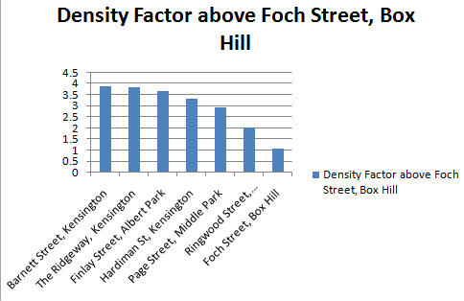
What Does 2011 Density Show?
Macaulay Precinct is 4 times the density of a Box Hill “Quarter Acre” Precinct

Slide 4
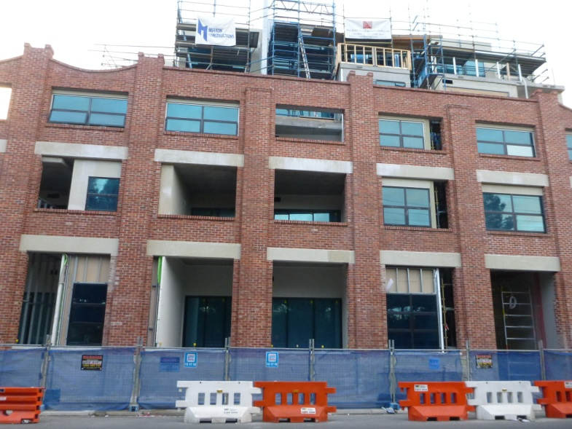
Crowded Kensington – becomes Jam-Packed Kensington?
Data analysis must state the assumptions before we can begin discussion
What actually is “High Density”
What is an unreasonable density given the actual or likely infrastructure?
Multiple density of Hardiman Street – 31 times Foch Street?

Slide 5
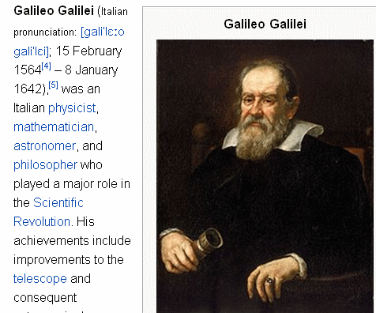
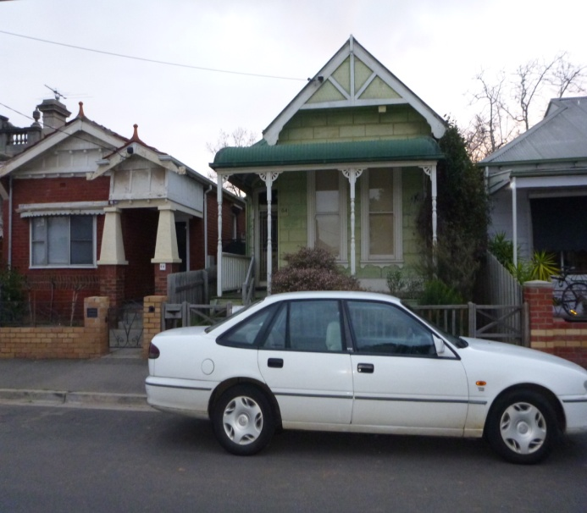
Defined Debate
Galileo established the scientific principle of “valid data”
Councillors must consider the impact of their vote on current residents
Do we really know the likely impacts of increasing population densities by factors of 5,10 or even 30 times?
( John Widmer – 2012 )
Kensington residents have already squeezed up!

